Slide 1
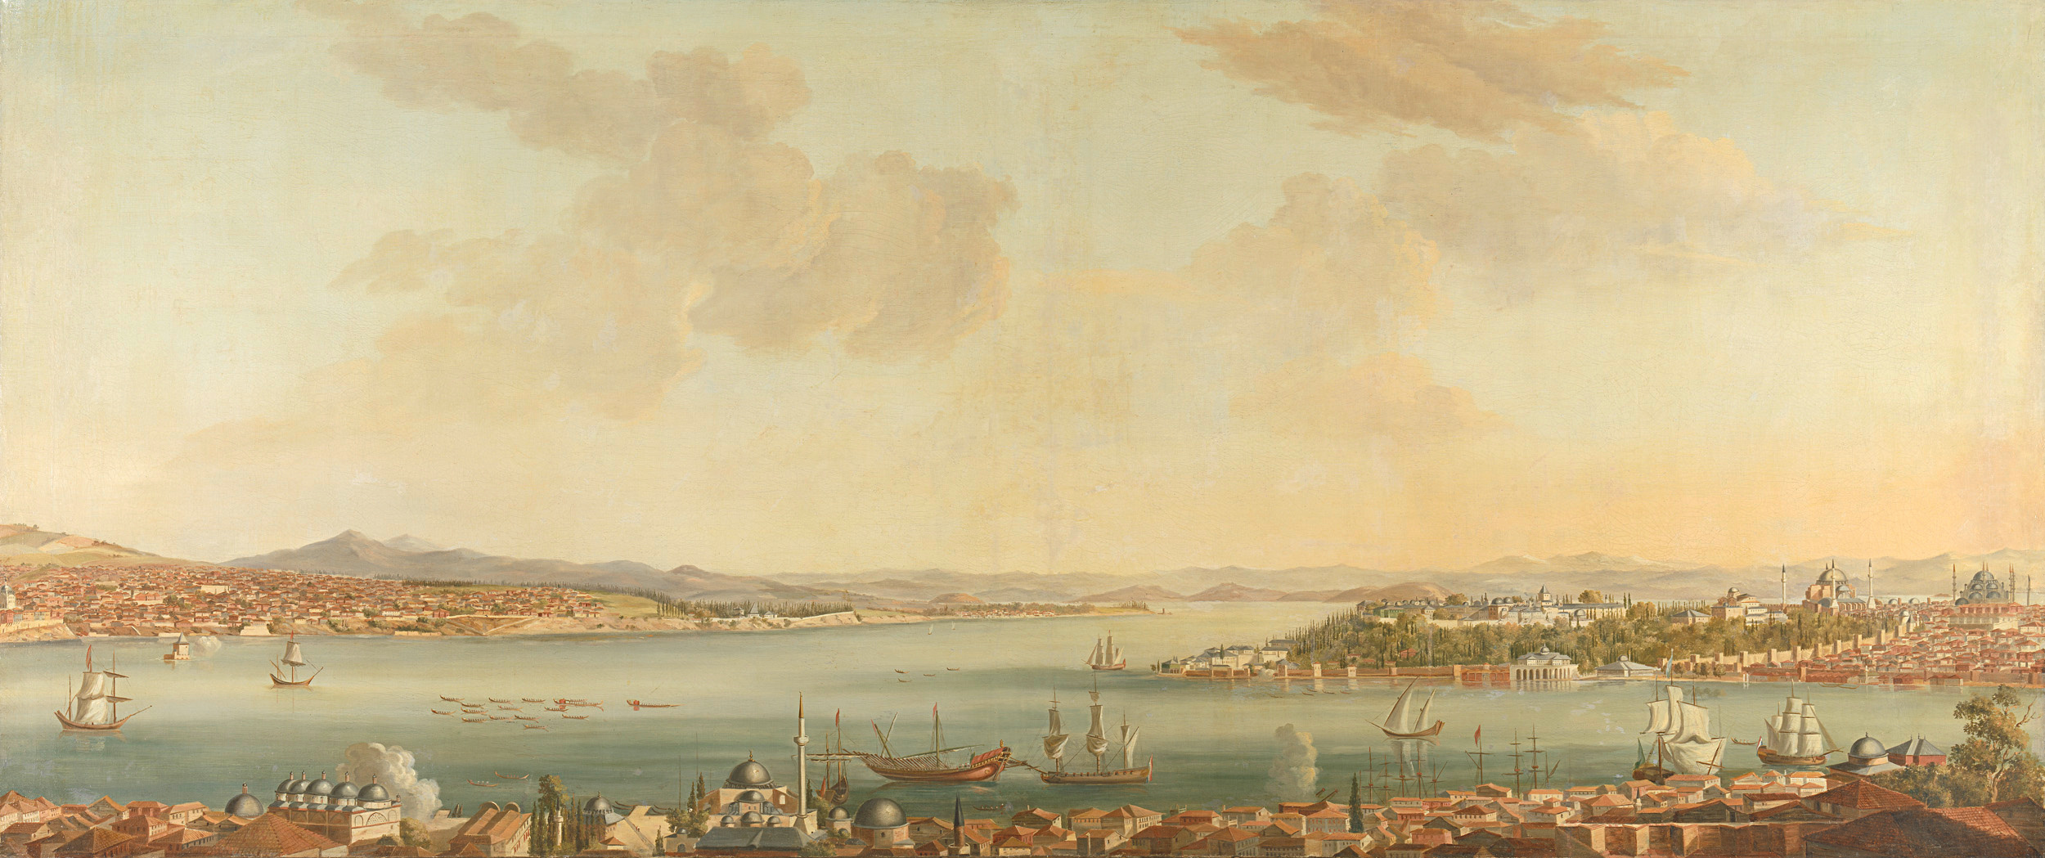

WILD
AUSTRALIA
Presented By - Asadullah Chaudhary

Slide 2
Introduction
WildAustralia is a dynamic WordPress website dedicated to showcasing the incredible diversity and beauty of Australia. Whether you're a nature enthusiast, a traveler, or someone simply curious about the Land Down Under, WildAustralia offers a comprehensive exploration of the country's most iconic landmarks, unique wildlife, and rich cultural heritage. From the breathtaking vistas of the Great Barrier Reef and Uluru to the fascinating stories behind Australia's festivals, cuisine, and traditions, this site serves as your gateway to discovering the essence of Australia. With engaging articles, stunning imagery, and insightful guides, WildAustralia invites visitors to embark on a virtual journey through one of the world's most extraordinary destinations

Slide 3
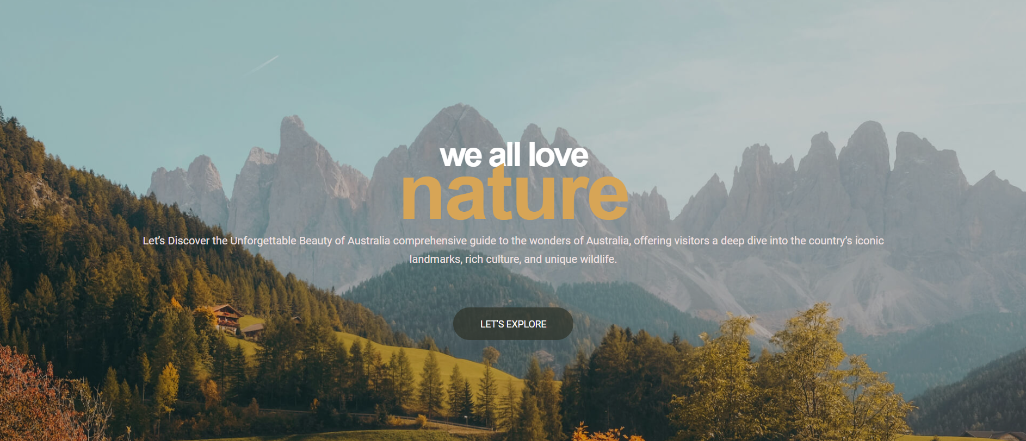
Division
We have divided our web into multiple chunks:
Home / Introductory Part
Australian Landmarks
Australian Wildlife
Australian Culture
Contact Form

Slide 4
Vision and Mission
The mission of WildAustralia is to provide engaging, informative, and visually captivating content that highlights the best of Australia’s landmarks, wildlife, and cultural experiences. By offering a platform that combines educational resources with immersive storytelling, audience.

Slide 5
PROJECT
Screenshots

Slide 6
Part 1
This is home or introductory part of our website.

Slide 7
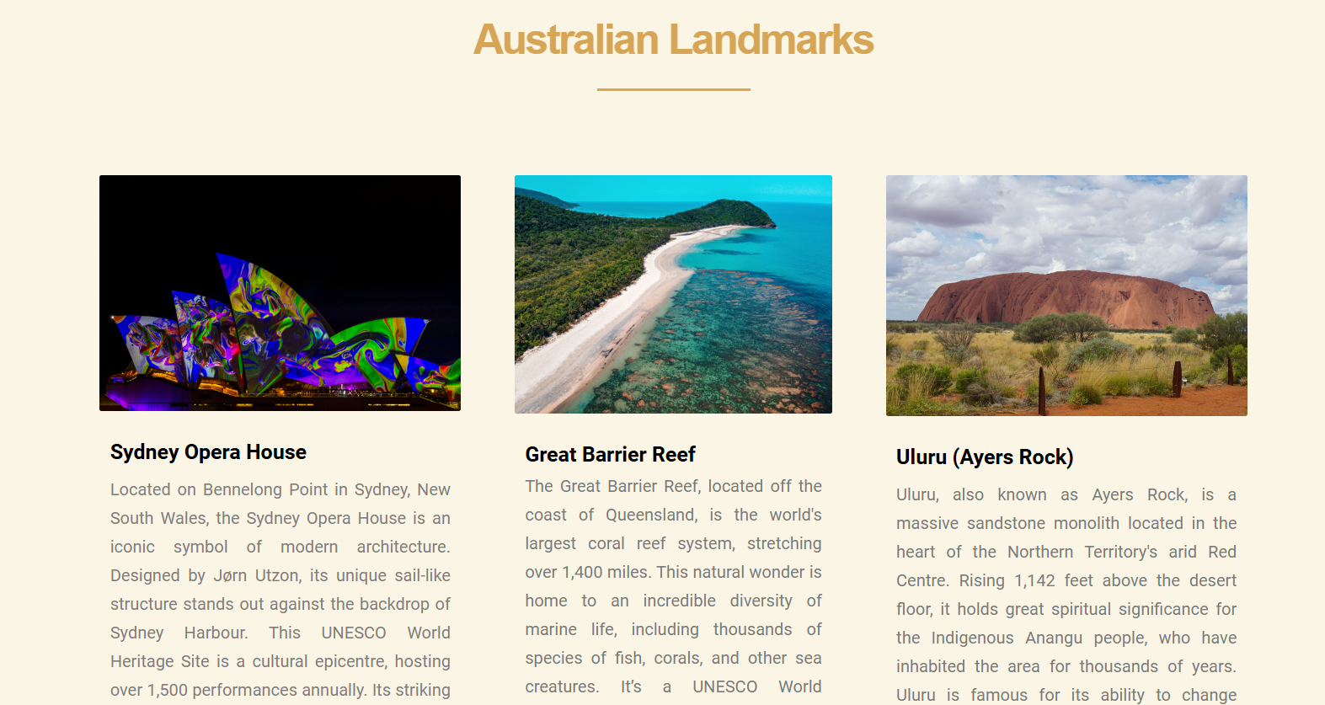
Part 2
Her we got the Australian Landmarks with their complete details and description

Slide 8
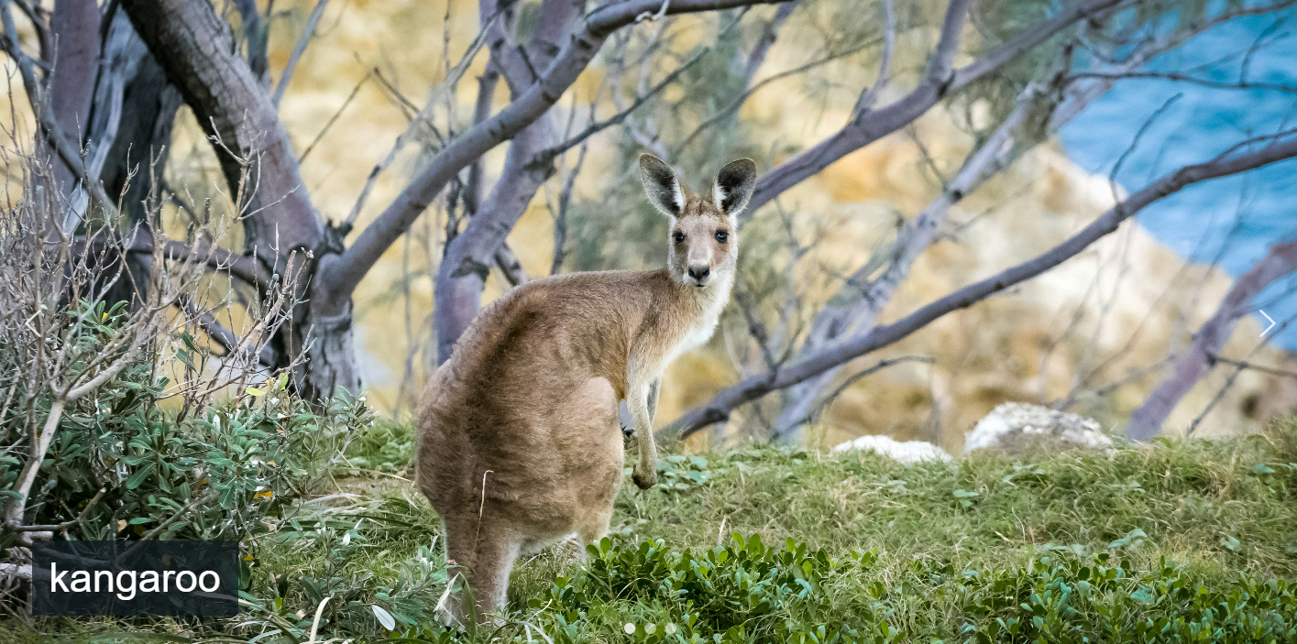
Australian Wildlife is presented
in this part of the web.
Part 3

Slide 9

Part 4
This section represents the Australian
Life style and Culture

Slide 10
THANK YOU
Presenter:
Asadullah Chaudhary

